Slide 1
From virtualisation… … to the cloud

Slide 2
Sources
Tanenbaum & Bos – Modern Operating Systems
BNP Paribas & BNPP Fortis presentations
VMware presentations
Microsoft MSDN
Wikipedia
Scribd presentations (Abhished Seth…)
Free presentations

Slide 3
Issues
More and more powerful servers
Complexity of application coexistence
➔ underused hardware
Diversity of hardware, OS, OS versions…
HP, Dell, Lenovo…
Linux Vx.y, Windows 2008/2012/2016 …
Workstations Windows 7/8/10, MAC, tablets, smartphones…

Slide 4
Virtualisation – why?
Economics: Save money and energy, better usage of the available hardware
Simplicity: Simplify management, continuity, backup, support, installations and upgrades
Scalability: add/remove resources to a server (workstation…), add/remove servers(…) on an existing infrastructure, migrate
Performance
Security, control…

Slide 5
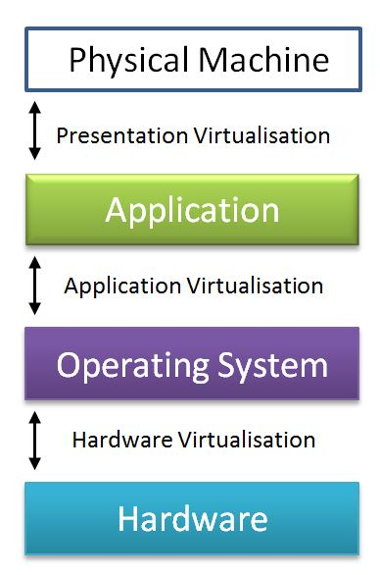
Virtualisation – what?
Server virtualisation
Workstation virtualisation
Network virtualisation
Storage virtualisation
Application virtualisation

Slide 6
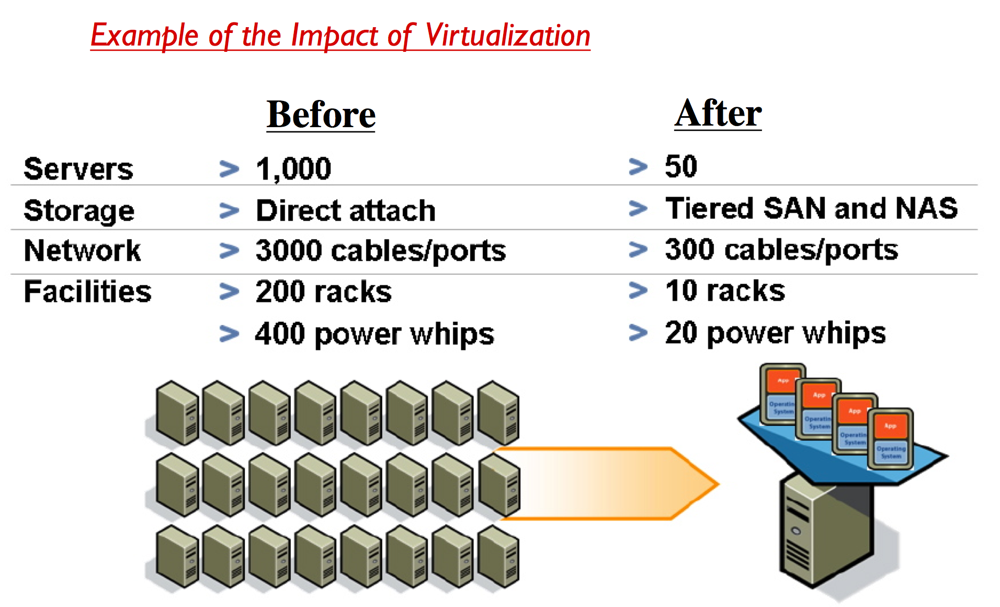

Slide 7
Server virtualisation

Slide 8
Server Virtualisation – Who?
VMware VMware, ESXi, vSphere
Microsoft Hyper-V
Citrix XenServer
Oracle Oracle VM VirtualBox
IBM PowerVM
Originally developed in the 1970s by IBM

Slide 9
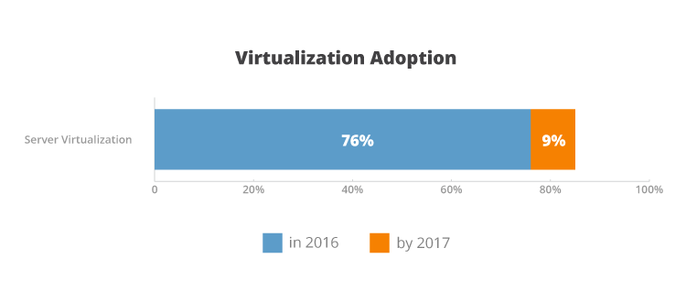
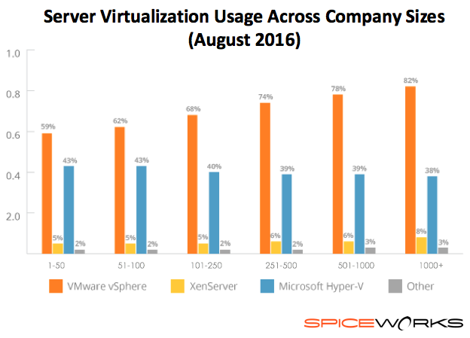
Notes:
Ce n’est pas juste un sujet pour grandes entreprises…

Slide 10
Servers virtualisation
Allows multiple OS instances to run concurrently on a single computer
Is a means of separating hardware from a single OS
Each “guest” OS is managed by a Virtual Machine Monitor (VMM), also known as a hypervisor.
The virtualisation system sits between the guest and the hardware, so it can control the guests’ use of CPU, memory, and storage, even allowing a guest OS to migrate from one machine to another.
Specially designed software allows an administrator to convert one physical server into multiple virtual machines.
Each virtual server acts like a unique physical device, capable of running its own operating system.

Slide 11
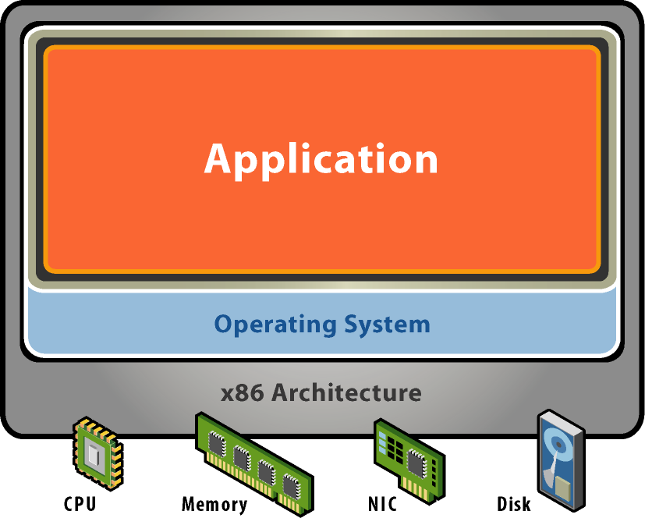
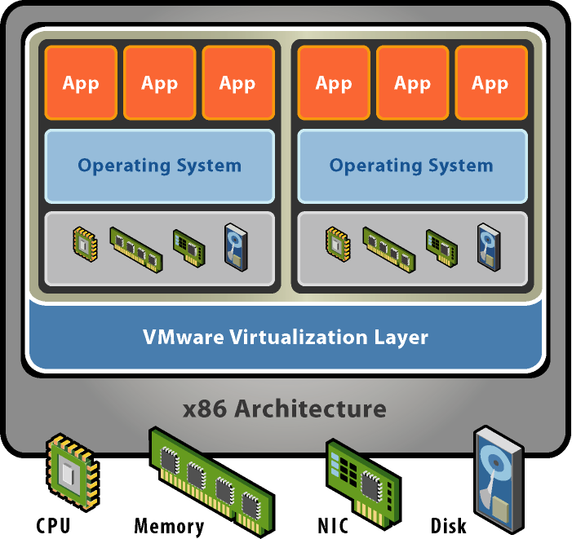


What is Virtualization? Example
Without Virtualization
With Virtualization
Application
Operating System
Hardware
VMware provides hardware virtualization that presents a complete x86 platform to the virtual machine
Allows multiple applications to run in isolation within virtual machines on the same physical machine
Virtualization provides direct access to the hardware resources to give you much greater performance than software emulation

Slide 12
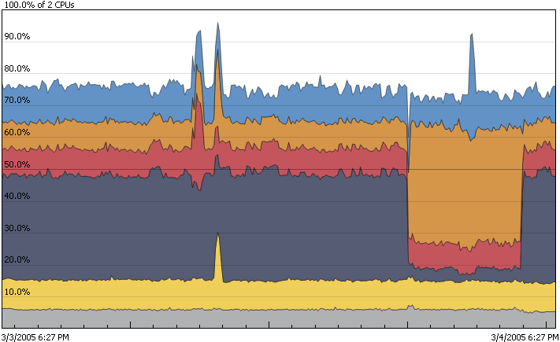
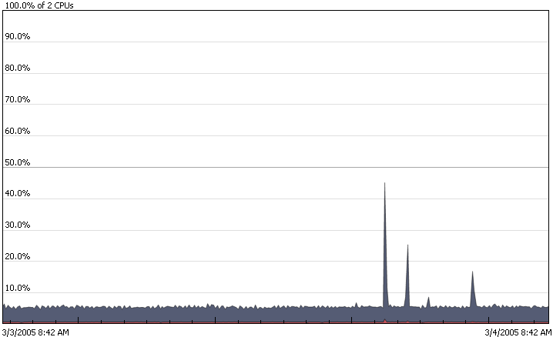
Virtualization Increases Hardware Utilization
Before
After
Virtualization enables consolidation of workloads from underutilized servers onto a single server to safely achieve higher utilization

Slide 13
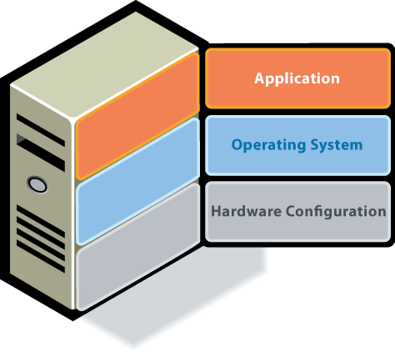
Virtualisation Technology Overview
The Challenge
Old Model: Traditional x86 Architecture
Single OS image per machine
Software and hardware tightly coupled
Multiple applications often conflict
Underutilised resources
→ Old model is challenging!

Slide 14
Hosted software Server Virtualization
VMware Server

Slide 15
Software Server Virtualization Architecture
V i r t u a l
Applications
Applications
Applications
Guest OS (Windows)
Guest OS (Linux)
Guest OS (VMware ESX)
Virtual Machine
Virtual Machine
Virtual Machine
P h y s i c a l
Virtual Machine Manager (Server Products)
Host OS (Server Products)
Hardware

Slide 16
Hosted software Virtualisation
Generally more overhead and less performance than their native counterparts.
Examples:
Microsoft Virtual Server
VMware GSX Server for Windows
VMware GSX Server for Linux
VMware workstation
Special case: OS level virtualisation →

Slide 17
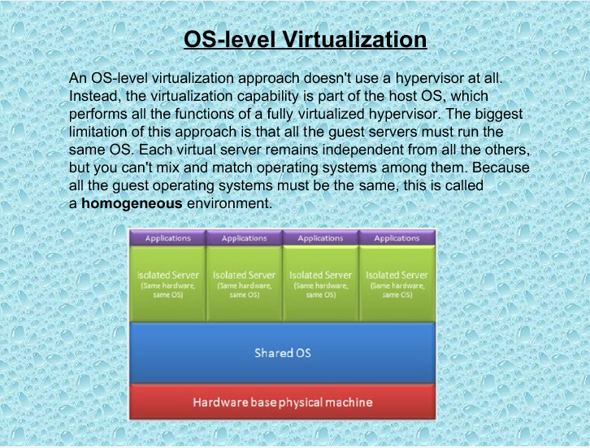

Slide 18
OS level Virtualisation
No real hypervisor, only use host OS capabilities
Fast, lightweight, and efficient
Very limited functionality
Same OS everywhere
relying on the Host OS for CPU scheduling, memory management
Examples:
Very UNIX oriented: OpenVZ, Virtuozzo, Solaris Zones
PC

Slide 19
HardV Server Virtualization
Microsoft Virtual Server
Citrix XenServer
VMware ESX Server
Microsoft Hyper-V Server
VMware ESXi Server

Slide 20
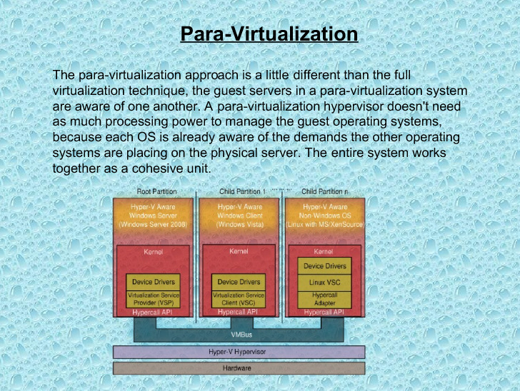

Slide 21
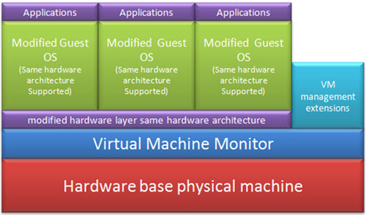
Para-Virtualization

Slide 22
Para-Virtualization
Lightweight and fast
The guest has to be aware of the virtualisation layer, and must be adapted to include hypercalls
Examples:
IBM VM (1972)
XEN 1.0, UML…

Slide 23
HardV “Type 2” Server Virtualization Architecture
V i r t u a l
Applications
Applications
Guest OS (Windows)
Guest OS (Linux)
Virtual Machine
Virtual Machine
Host OS
Virtualization Layer
P h y s i c a l
Hardware

Slide 24
HardV “Type 2” Server Virtualization Architecture
Applications
Applications
Applications
V i r t u a l
Guest OS (Windows)
Guest OS (Linux)
Guest OS (VMware ESX)
Virtual Machine
Virtual Machine
Virtual Machine
Host OS + Virtualization Layer
P h y s i c a l
Hardware

Slide 25
“Type 2” Server Virtualization
Examples:
Microsoft Hyper-V (different versions)
VMware Server, VMware Workstation 1
Hyper-V is in fact MS Windows, with all virtualization functionality enabled, and all non required functionality disabled…
Similar for Linux KVM (Red Hat)
Hyper-V & KVM can be considered Type 2 or 1…

Slide 26
HardV “Type 1” Server Virtualization Architecture
Applications
Applications
Applications
V i r t u a l
Guest OS (Windows)
Guest OS (Linux)
Guest OS (VMware ESX)
Virtual Machine
Virtual Machine
Virtual Machine
Virtualization Layer (Hypervisor)
P h y s i c a l
Hardware

Slide 27
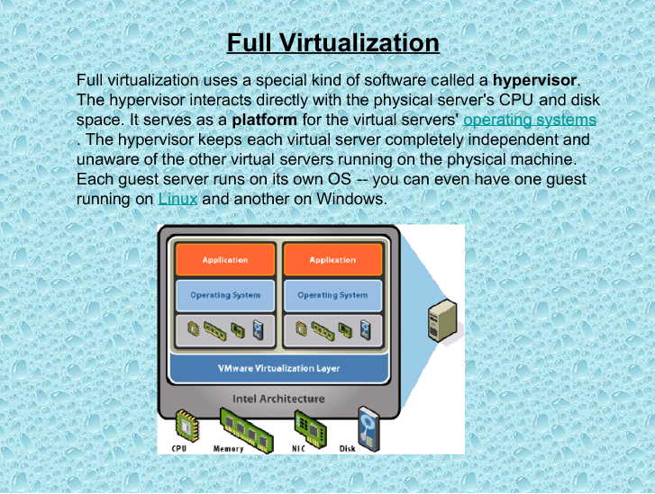

Slide 28
“Type 1” = “Full” Virtualization
Also called native, or bare-metal hypervisors
Safety: hypervisor has full control of the virtualized resources
Fidelity: no adaptations required to the programs
Efficiency: much code in VM should run without intervention by the hypervisor
Examples:
VMware ESX, ESX Server
Microsoft Hyper-V (2012)
Citrix XenServer

Slide 29
What is a hypervisor?
A hypervisor, also called a virtual machine manager (VMM), is a program that allows multiple operating systems to share a single hardware host.
Each operating system appears to have the host's processor, memory, and other resources all to itself.
However, the hypervisor is actually controlling the host processor and resources, allocating what is needed to each operating system in turn and making sure that the guest operating systems (called virtual machines) cannot disrupt each other.

Slide 30
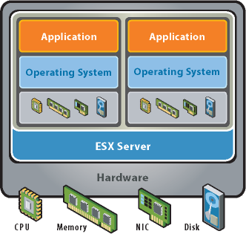
Key Properties of Virtual Machines
Partitioning
Run multiple operating systems on one physical machine
Divide system resources between virtual machines

Slide 31
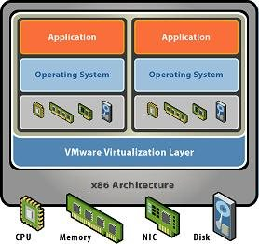
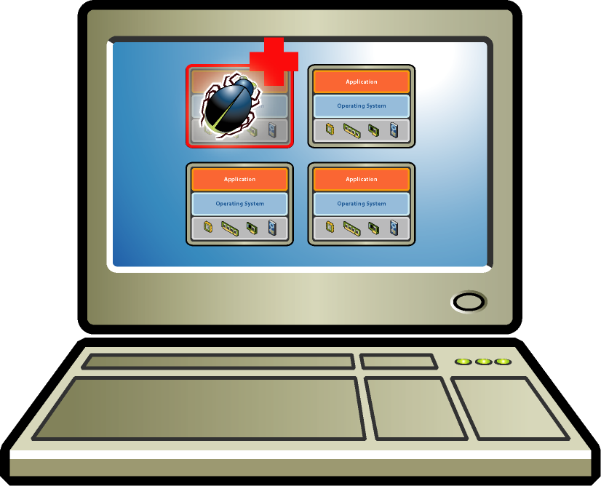
Key Properties of Virtual Machines
Partitioning
Run multiple operating systems on one physical machine
Divide system resources between virtual machines
Isolation
Fault and security isolation at the hardware level
Advanced resource controls preserve performance

Slide 32
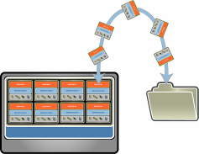
Key Properties of Virtual Machines
Partitioning
Run multiple operating systems on one physical machine
Divide system resources between virtual machines
Isolation
Fault and security isolation at the hardware level
Advanced resource controls preserve performance
Encapsulation
Entire state of the virtual machine can be saved to files
Move and copy virtual machines as easily as moving and copying files

Slide 33
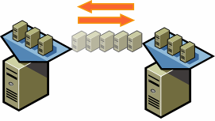
Key Properties of Virtual Machines
Partitioning
Run multiple operating systems on one physical machine
Divide system resources between virtual machines
Isolation
Fault and security isolation at the hardware level
Advanced resource controls preserve performance
Encapsulation
Entire state of the virtual machine can be saved to files
Move and copy virtual machines as easily as moving and copying files
Hardware-Independence
Provision or migrate any virtual machine to any similar or different physical server

Slide 34
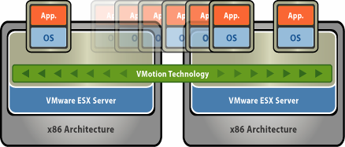
VMware VMotion
73% of VMware customers have implemented VMotion in production
Live migration of virtual machines
Zero downtime

Slide 35
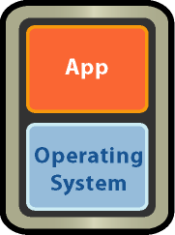
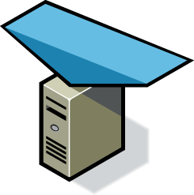
VMware DRS
67% of VMware customers use DRS in production
Business Demand
Dynamic and intelligent allocation of hardware resources
Ensure optimal alignment between business and IT
Resource Pool

Slide 36
Ensure High availability with VMware HA
VMware HA automatically restarts virtual machines when a physical server fails
X
Resource Pool

Slide 37
Distributed Power Management (coming soon)
NEW!
Minimize power consumption while guaranteeing service levels
Business Demand
Consolidates workloads onto fewer servers when the cluster needs fewer resources
Places unneeded servers in standby mode
Brings servers back online as workload needs increase
Power Off
Resource Pool

Slide 38
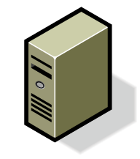

Non-disruptive ESX Server Patching with Update Manager and DRS
Update Manager
Update Manager patches entire DRS clusters
Each host in the cluster enters DRS maintenance mode, one at a time
VMs are migrated off, host is patched & rebooted if required
VMs are migrated back on
Next host is selected
VMotion
VMotion

Slide 39
Techniques of VMware
VMotion
Storage VMotion
High Availability
Memory Reclamation

Slide 40
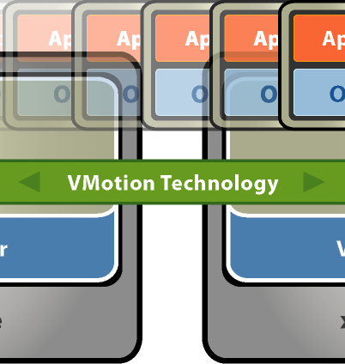
VMotion
VMotion allows you to quickly move an entire running virtual machine from one host to another without any downtime or interruption to the virtual machine This is also known as a “hot” or “live” migration.
The entire state of a virtual machine is encapsulated and the VMFS file system allows both the source and the target ESX host to access the virtual machine files concurrently. The active memory and precise execution state of a virtual machine can then be rapidly transmitted over a high speed network. The virtual machine retains its network identity and connections, ensuring a seamless migration process.

Slide 41
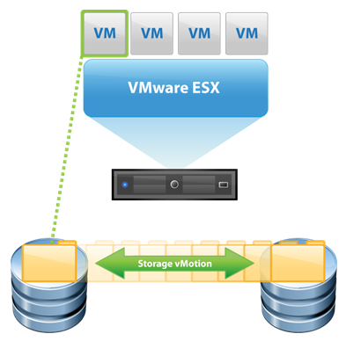
Storage VMotion
Storage VMotion is a new feature introduced in ESX 3.5, it allows you to migrate a running virtual machine and its disk files from one datastore to another on the same ESX host
The difference between VMotion and Storage VMotion is that VMotion simply moves a virtual machine from one ESX host to another but keeps the storage location of the VM the same, Storage VMotion on the other hand changes the storage location of the virtual machine while it is running and moves it to another datastore on the same ESX host. The virtual machine can be moved to any datastore on the ESX host which includes local and shared storage.

Slide 42
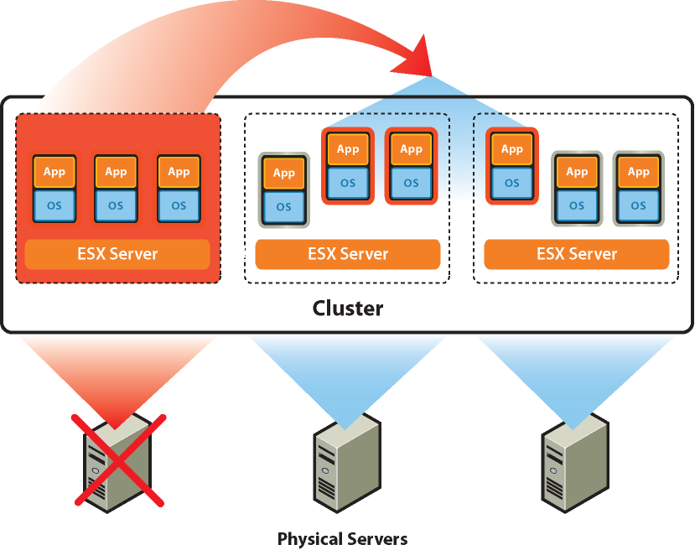
High Availability (HA)
Continuously monitors all hosts in a cluster and restarts virtual machines affected by a host failure on other hosts
Can also monitor guest OS's for a failure via a heartbeat and restart them on the same host in case of a failure
Continuously monitors and chooses the optimal physical servers within a resource pool on which to restart virtual machines (if used in conjunction with DRS)

Slide 43
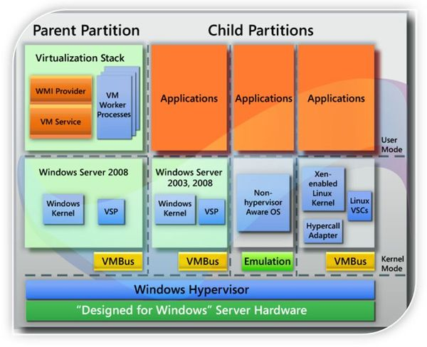
Hyper-V

Slide 44
Some Hyper-V functionality
Multiple OS support
Windows Servers, clients, Linux, Ubuntu, SUSE
Live migrations, export and cloning
Dynamic memory allocation
Shared virtual disks
…

Slide 45
Full-Virtualization – Summary
Ability to run multiple different OS
Transparent to applications
Overhead: requires multiple OS installations!
Not adequate for I/O intensive applications

Slide 46
Application virtualisation
Application virtualisation

Slide 47
Application virtualisation (Wikipedia)
Software technology that encapsulates computer programs from the underlying operating system
A fully virtualized application is not installed in the traditional sense although it is still executed as if it were.
The application behaves at runtime like it is directly interfacing with the original operating system and all the resources managed by it, but can be isolated or sandboxed to varying degrees.

Slide 48
Application virtualisation advantages
Transparent: the application remains unaware that it accesses a virtual resource instead of a physical one.
Easy to run the application on a different computer, no hardware dependencies
Previously incompatible applications can be run side-by-side.
Simplified sandboxing, testing, deployment…

Slide 49
APP-V – Deploy on request
App-V client needs to be installed on the client
Application deployed on request – only when used
"streamed" in real-time to any client cache from a virtual application server ➔ removes the need for traditional local installation… (push)
… or pre-installed in a local cache (pull).

Slide 50
Server Based Computing (SBC) Application virtualisation on servers
Make applications available to end users without installing the applications directly on end user computers
applications are implemented, controlled, supported and executed on a server instead of a client
Same application can be run multiple times for different users
Effort required in packaging end-user applications for the Windows Server OS that hosts most SBC solutions

Slide 51
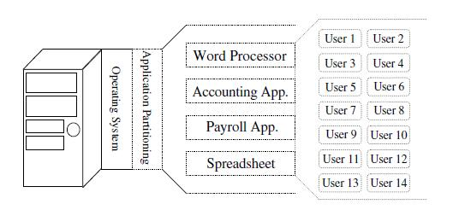
Application virtualisation
Examples for the Windows platform:
Citrix XenApp
Microsoft APP-V, Remote Desktop Services
VMware ThinApp

Slide 52
Accessing virtualised applications
Users remotely attach to the server via a remote display protocol
Independent Computing Architecture (ICA) from Citrix
Remote Desktop Protocol (RDP) from Microsoft
PC-over-IP (PCoIP) from VMware
Runs on a PC, thin client or other client device, including many tablets and other mobile devices.
All the program logic, data and user interfaces reside on the server. The only activity local to the user includes the on-screen presentation, keyboard strokes and mouse movements.

Slide 53
Application virtualisation use cases
Easier management: deployment, patching …
Support of multiple clients: desktop/laptop, Windows or OS X, tablets, smartphones…
Support of uncontrolled devices (private PC, external consultants…)
Support of heavy (CPU, network traffic)or latency sensitive applications (branches, regional call centre)

Slide 54
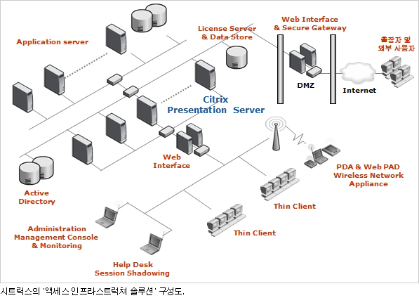
SBC typical architecture – Citrix case

Slide 55
Presentation virtualisation
Workstation virtualisation

Slide 56
Workstation (or desktop) virtualisation
Ultimate stage of application virtualisation: virtualise the entire workstation: separate the desktop environment and associated application software from the physical client device that is used to access it.
HVD Hosted Virtual Desktop
VDI Virtual Desktop Infrastructure
BYOD Bring Your Own Device

Slide 57
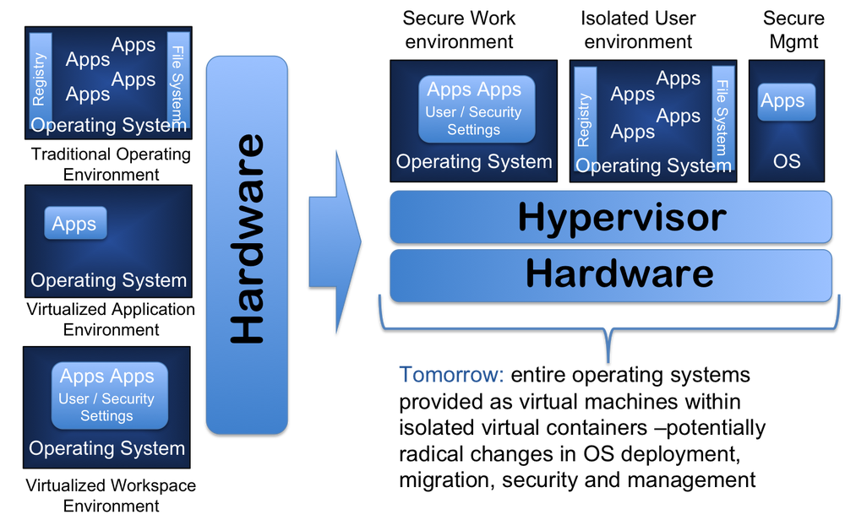
HVD architecture
Source: Amrit Williams Blog

Slide 58

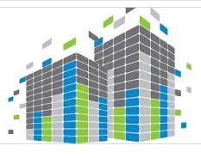
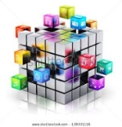
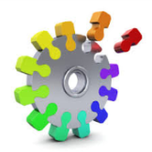

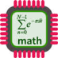
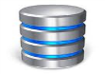
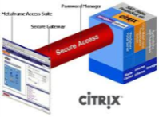
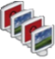
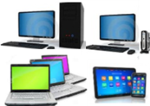
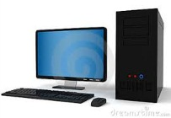
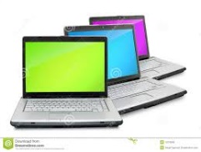



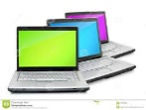
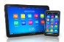
CloudOffice
Objectifs du service
Remplacer les…
…Par des…
POSTES DE TRAVAIL PHYSIQUES NeOS
POSTES DE TRAVAIL virtuels NeOS
Services applicatifs
Services d’infra.
Services applicatifs
Services d’infra
Service de machines virtuelles CloudOffice
Datacenters
Marne Nord / Marne Sud
HVD*
Consolidation des ressources postes de travail en datacenter
Flux applicatifs & infrastructure
Flux d’images
Desktop
NeOS
Postes de travail physiques BNPP
Laptop NeOS
Immeubles de bureaux
Fonctions & Métiers
Desktops, laptops, terminaux Ultra Légers (TUL) & tablettes Corporate et non corporate

Slide 59
HVD Advantages
Accessible through many types of devices
Desktop, laptop, tablets, smartphone
Windows, OS X, IOS, Android…
Company owned, consultant, private devices
Inside or outside company buildings
Easier management:
Deployment, patching …
Test and Training workstations
Industrialisation

Slide 60
HVD Advantages (2)
No need to deploy heavy workstations for consuming applications (CPU, network traffic)
E.g. also development workstations
Use the power of the server
Mobility, Remote Access & work@home...
Data security
Only screen images go outside the datacentre
Consolidation, back-up…

Slide 61
HVD major providers
Citrix XenDesktop
VMware Workstation, Horizon View
Microsoft Virtual PC, Remote Desktop Services

